Slide 1
PPT on “online voting system ”
Submitted by
ALOK KUMAR USN: SG20CSE019
DHANRAJ M USN: SG20CSE047
ABHISHEK S THAKUr USN: SG20CSE005
AATMEEYA PATIl USN: SG20CSE058
Under the Guidance of
PROFF.SHARANAMMA M..H

Slide 2
Introduction
the presented web page offers a delightful and user-centric online voting experience. Its modern design, dynamic animations, and clear presentation of voting options and results make it an attractive and efficient platform for users to cast their votes and view the outcome of the voting process.
Throughout the web page, consistent design principles are applied, ensuring a seamless and intuitive user experience. The use of large fonts, vibrant colors, animations, and a visually striking background contribute to an engaging and interactive voting process.

Slide 3
ADVANTAGES
Clear Vote Confirmation: The animated "Vote" button provides visual feedback upon clicking, ensuring that users are aware that their vote has been successfully registered. This feature eliminates uncertainty and reinforces the user's confidence in the voting process.
User-Friendly Interface: The web page features a user-friendly and intuitive interface with large fonts and clear labels, making it easy for users of all ages and technical backgrounds to navigate and cast their votes without confusion.

Slide 4
OBJECTIVE
Transparency: The real-time display of voting results on the result page promotes transparency in the voting process. Participants can instantly see the distribution of votes for each option, contributing to an open and accountable voting environment.
Accessibility: By using large fonts, clear labels, and responsive design, the web page aims to ensure accessibility for a diverse range of users, including those with visual impairments or disabilities.

Slide 5
LANGUAGE SPECIFICATIONS
HTML (Hypertext Markup Language): HTML is the standard markup language used to structure the content of web pages. It defines the elements and layout of the page, such as headings, paragraphs, images, links, forms, and more.
CSS (Cascading Style Sheets): CSS is used to control the visual presentation of the web page. It's responsible for styling elements, such as fonts, colors, spacing, borders, and animations. CSS allows you to make the web page visually appealing and responsive.
JavaScript: JavaScript is a programming language that adds interactivity and dynamic behavior to the web page. It can be used to create animations, handle user interactions (like clicking buttons), update content without refreshing the page (AJAX), and perform various other client-side tasks.
Python (Backend Language): While Python is not typically used directly in the front-end (user interface) of the web page, it can be used on the server-side to handle data processing, storage, and communication with a database. Python frameworks like Django or Flask are commonly used for building the backend of web applications.

Slide 6
Features of python:
Interpreted Language: Python is an interpreted language, meaning code is executed line by line by an interpreter. This allows for rapid development and testing.
Multi-Paradigm: Python supports multiple programming paradigms, including procedural, object-oriented, and functional programming, giving developers flexibility in how they write code.
Extensive Standard Library: Python comes with a comprehensive standard library that provides ready-to-use modules and functions for various tasks, such as file handling, networking, regular expressions, and more.
Third-Party Libraries: Python has a vast ecosystem of third-party libraries and frameworks that extend its functionality for specific purposes. Examples include Django and Flask for web development, NumPy and pandas for data analysis, TensorFlow and PyTorch for machine learning, and more.
Cross-Platform Compatibility: Python is available for various platforms (Windows, macOS, Linux), making it easy to develop and run code across different operating systems.

Slide 7
WHAT DOES OUR PROJECT DO ?
Voting Options: The web page allows users to choose from three voting options: "option 1," "option 2," and "option 3." Users can select their preferred option by clicking on the corresponding radio button.
Real-Time Results: The project provides a result page that displays real-time updates on the voting outcome. Users can view the distribution of votes for each option, promoting transparency and accountability.

Slide 8
AFTER IMPLEMENtING CODE
The result page of the online voting system is a critical component that provides participants with real-time updates on the voting outcome. It allows users to see how each voting option has been performing and provides a transparent view of the overall results.

Slide 9
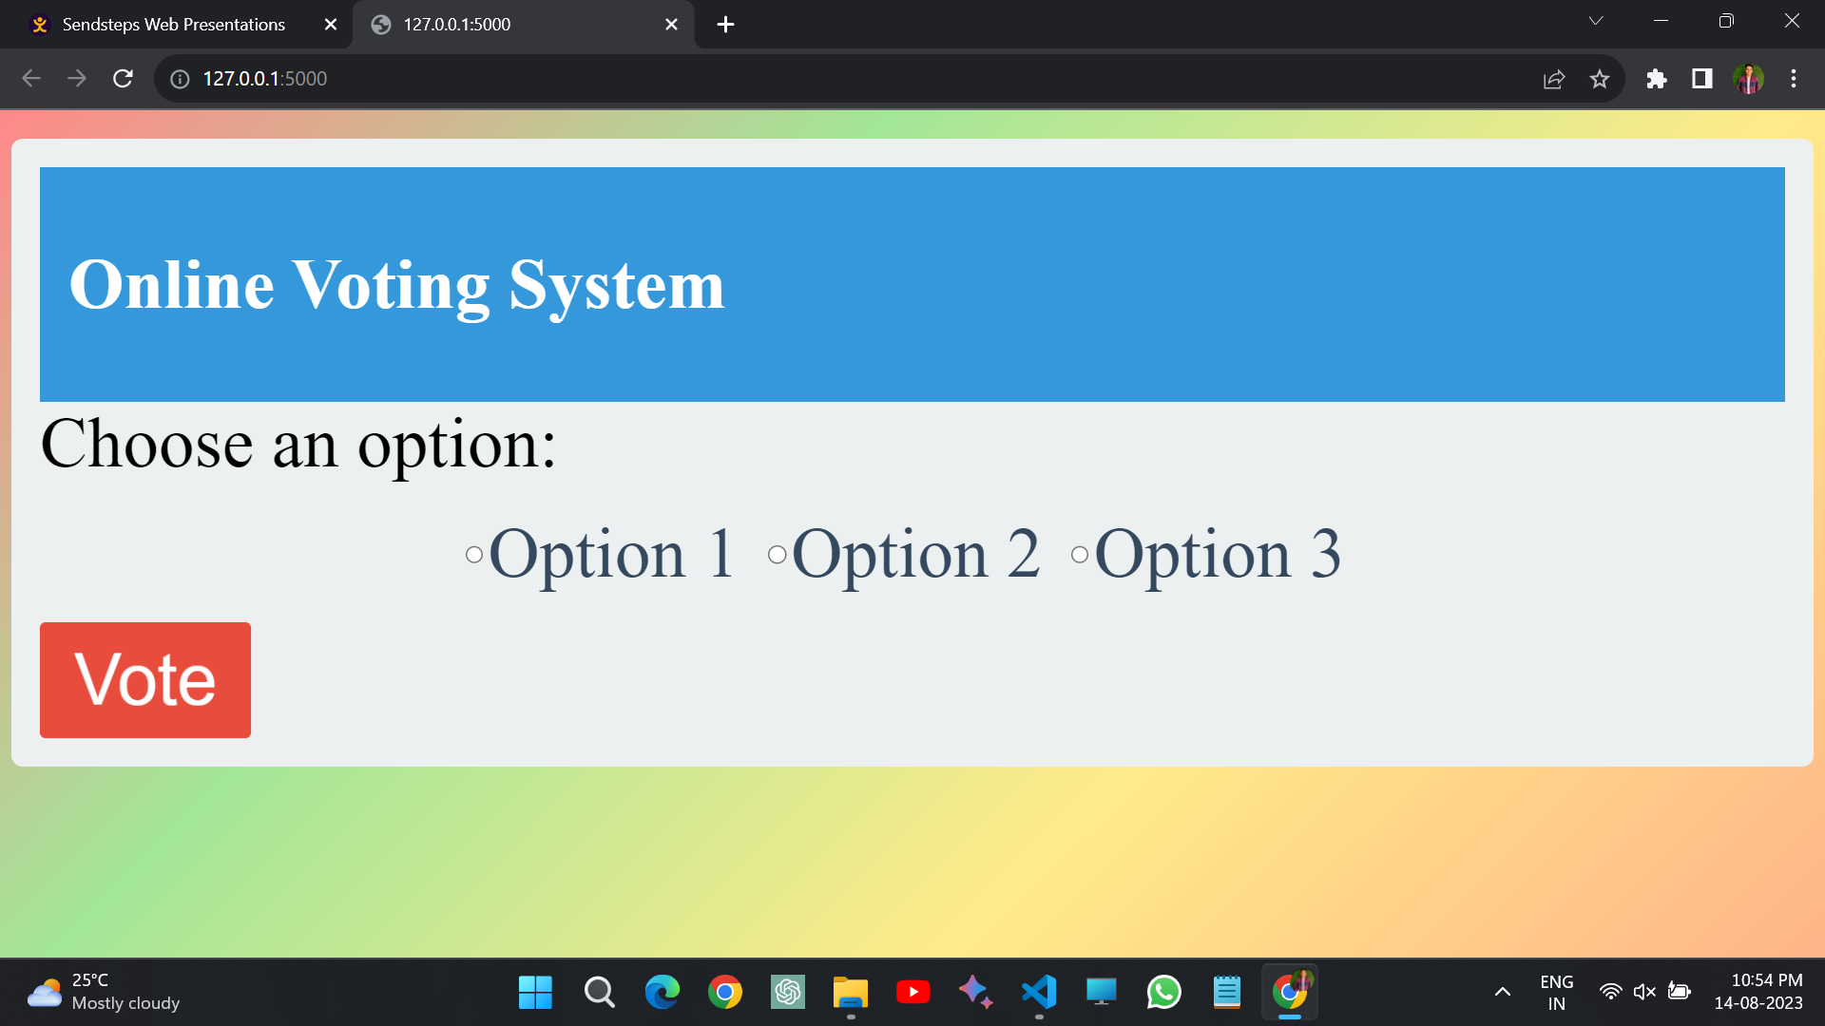
RESULTS

Slide 10
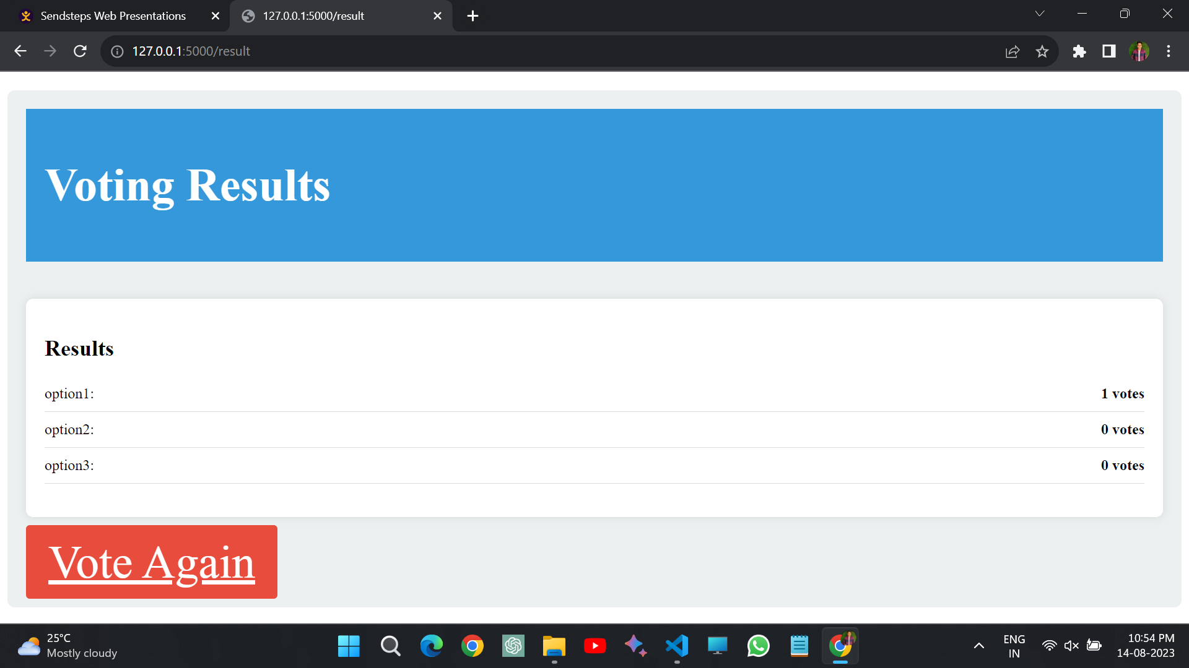
RESULTS AFTER ENTERING DATA REQUIERD

Slide 11
CONCLUSION
the online voting system web page successfully achieves its objectives by providing an engaging, efficient, and visually appealing platform for participants to cast their votes and view the results. By leveraging the strengths of HTML, CSS, Python, and JavaScript, the project creates a memorable and valuable experience that caters to diverse user needs and contributes to a more democratic and inclusive voting process.

